Slide 1











Table of
Contents
9 Aug 2025
Capstone
Project
Sauce Demo
Presented by:
Rakshit Bhadoria (Java Selenium Batch – 3)
Notes:
https://www.freepik.com/free-ai-image/photorealistic-timber-house-interior-with-wooden-decor-furnishings_152371631.htm

Slide 2





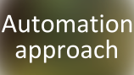














Table of
Contents
9 Aug 2025
Presented by:
Rakshit Bhadoria (Java Selenium Batch – 3)
Notes:
https://www.freepik.com/free-ai-image/photorealistic-timber-house-interior-with-wooden-decor-furnishings_152371631.htm

Slide 3


About
Project
Your super-duper awesome mission goes right here. 10x your PPT skills with One Skill.
One Skill
PPT Connoisseur

Slide 4
About
Project
Goal: Build an end-to-end automation framework for Sauce Demo web app.
Automate critical functionalities using Selenium + TestNG.
Enable CI/CD pipeline with Jenkins for automatic test execution.
Use GitHub for version control & collaboration.
Track requirements, test cases, and bugs using Jira + Zephyr Board.

Slide 5

Tools Used
Here are the problems that users have
87%
93%
97%
of the target audience is experiencing this problem
of the target audience is looking for an alternative
of the target audience reports it as the biggest pain

Slide 6
Tools Used
Core Automation & Framework
Collaboration & Project
CI/CD
Development Environment
Java, Selenium, TestNG, JUnit, Maven
Git/GitHub,
JIRA + Zephyr
Jenkins
Eclipse IDE

Slide 7

Automation
approach
Your
Solution
Benefit 1
Provide more information about this point. Keep it short and sweet
Benefit 2
Provide a bit more information about your super-duper awesome solution over here. Keep it easy peasy lemon squeezy.
Provide more information about this point. Keep it short and sweet
Benefit 3
Learn More
Provide more information about this point. Keep it short and sweet

Slide 8
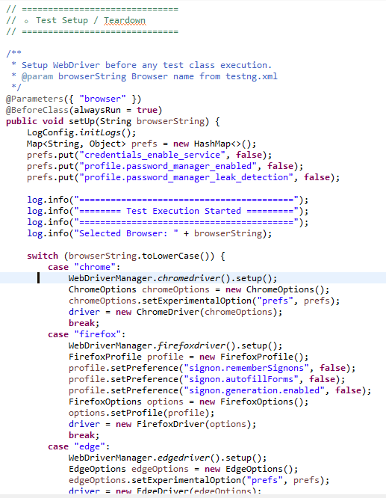
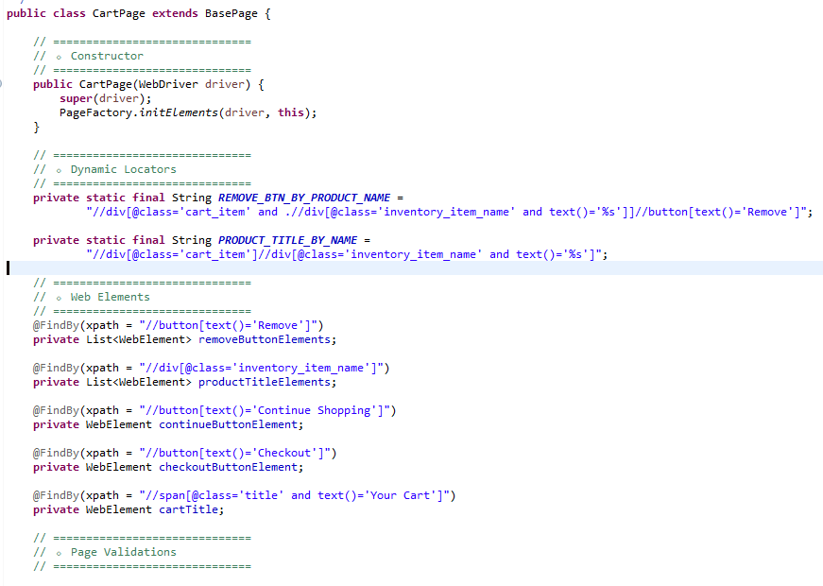
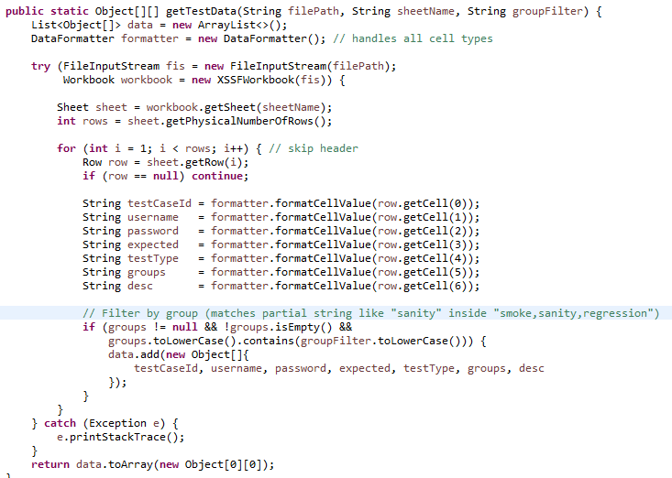
Automation
approach
Page Object Model
Data Driven Testing
Cross Browser Testing
separates page structure and test logic for maintainability
use excel to run tests with multiple inputs
validate application on Chrome, Firefox, etc.

Slide 9

Jira
Board
The market for our product is large and growing fast.
2024
2025
2026
2027
2028
2029

Slide 10
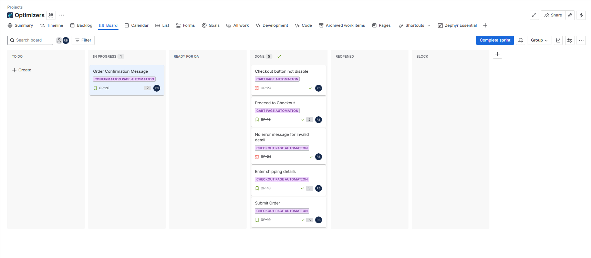
Link for Jira
Jira
Board
Board: Visual representation of tasks organized by status, enabling easy tracking of team work.

Slide 11
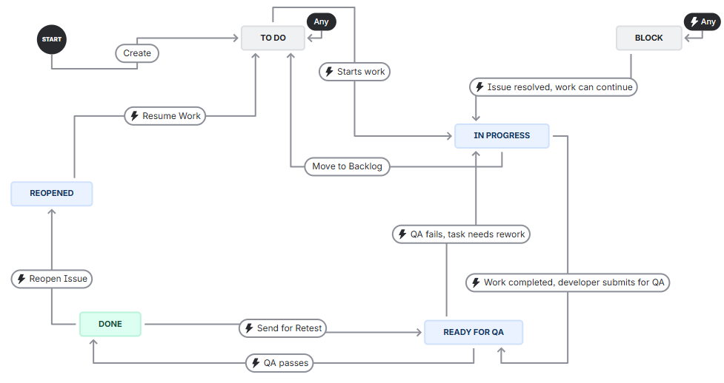
Link for Jira
Jira Board
Workflow – Shows the path each story, task, or bug follows
(e.g., To Do → In Progress → Review → Done).

Slide 12
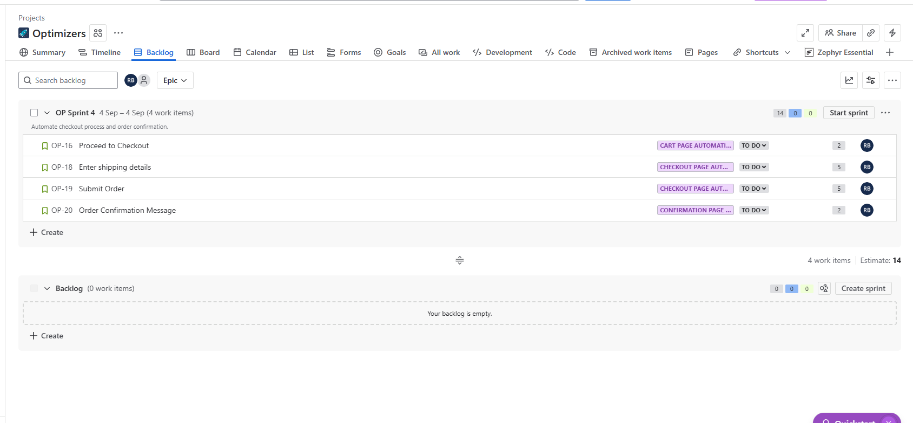
Link for Jira
Jira Board
Backlog – List of all pending user stories and tasks that are yet to be planned into sprints.

Slide 13
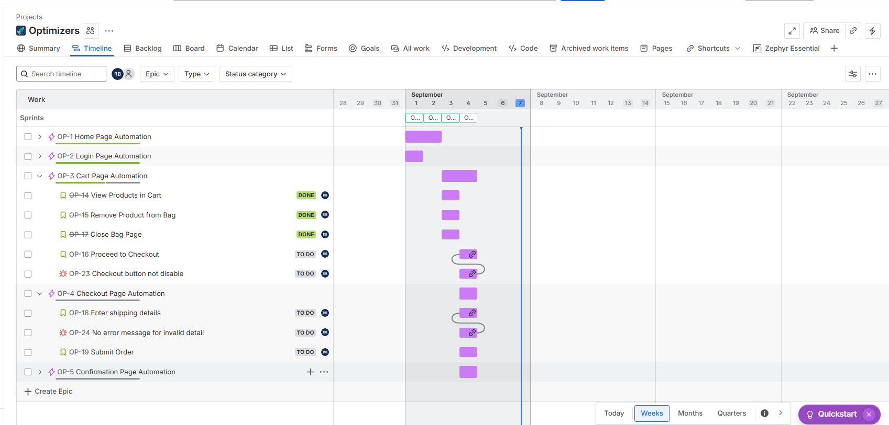
Link for Jira
Agile Board
Timeline – Displays epics and stories along a timeline, helping track progress and deadlines clearly.

Slide 14

Zephyr
Board
Overview of our
business model
1
2
3
4
5
Provide more info about this business model stage
Provide more info about this business model stage
Provide more info about this business model stage
Provide more info about this business model stage
Provide more info about this business model stage

Slide 15
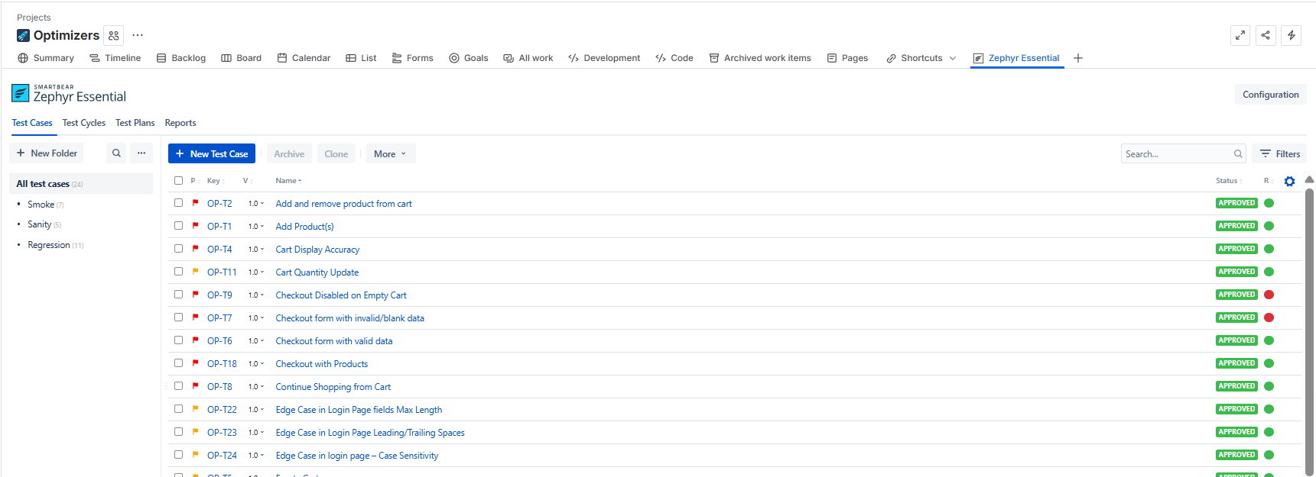
Zephyr
Board
Test cases: Repository showing all created test cases.

Slide 16
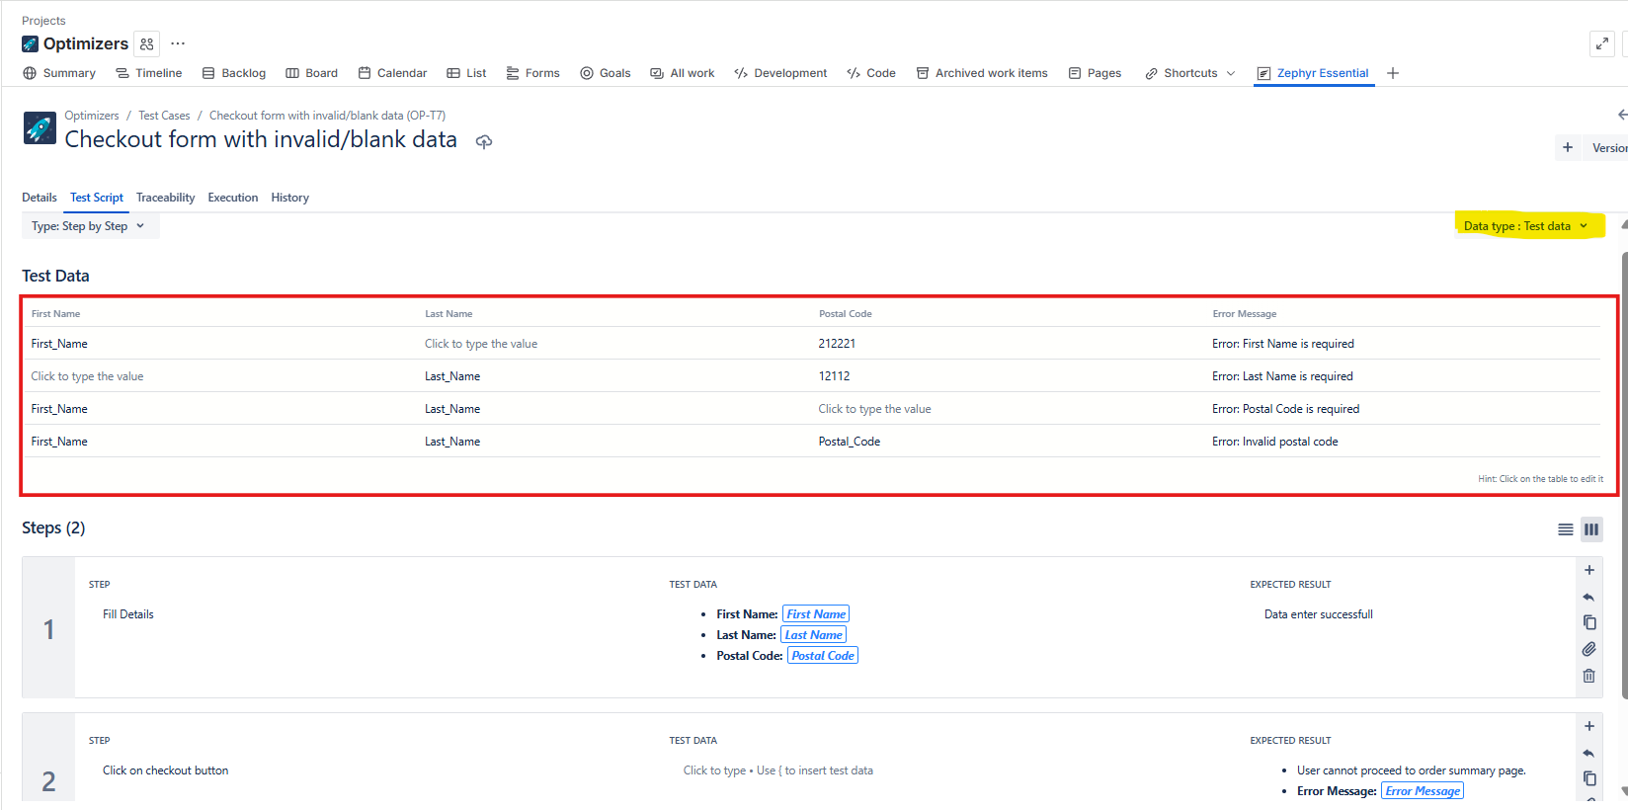
Zephyr
Board
Each test case is written with clear steps. Test Data field is used to provide multiple inputs. Same test case can run with different sets of data (data-driven).

Slide 17
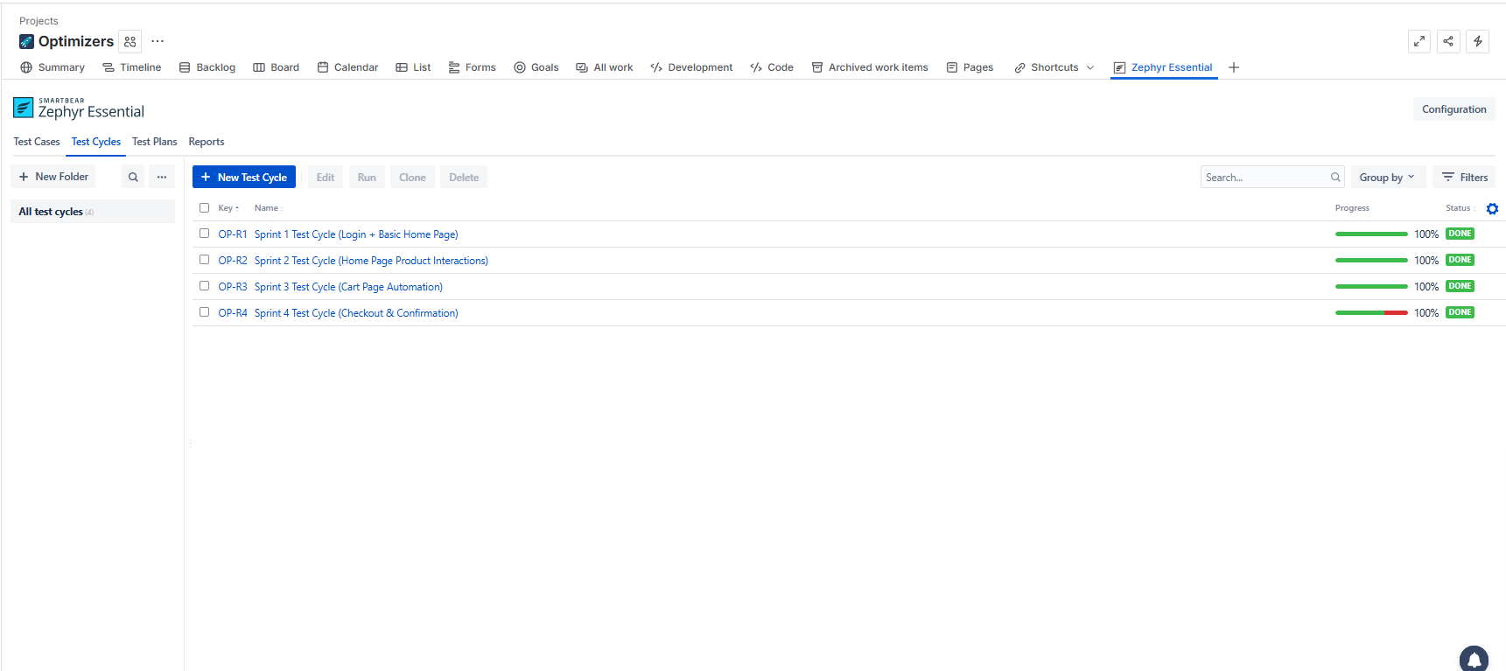
Zephyr
Board
Test Cycles – Collection of test cases grouped per sprint.

Slide 18
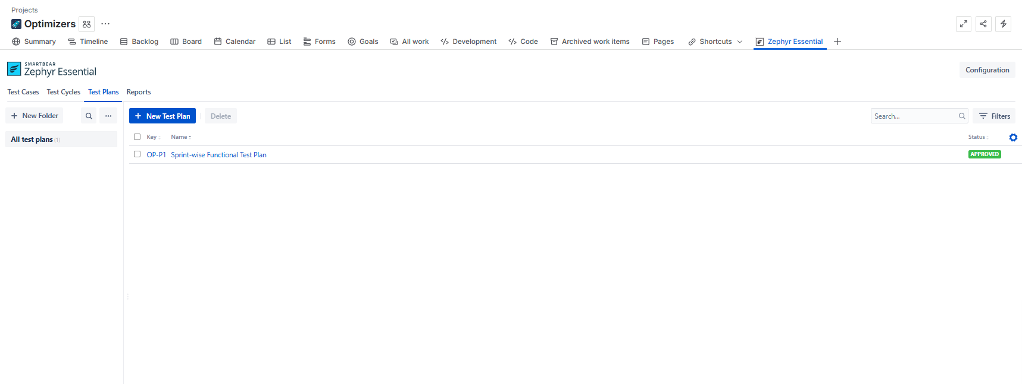
Zephyr
Board
Test Plan – High-level plan combining multiple test cycles.

Slide 19
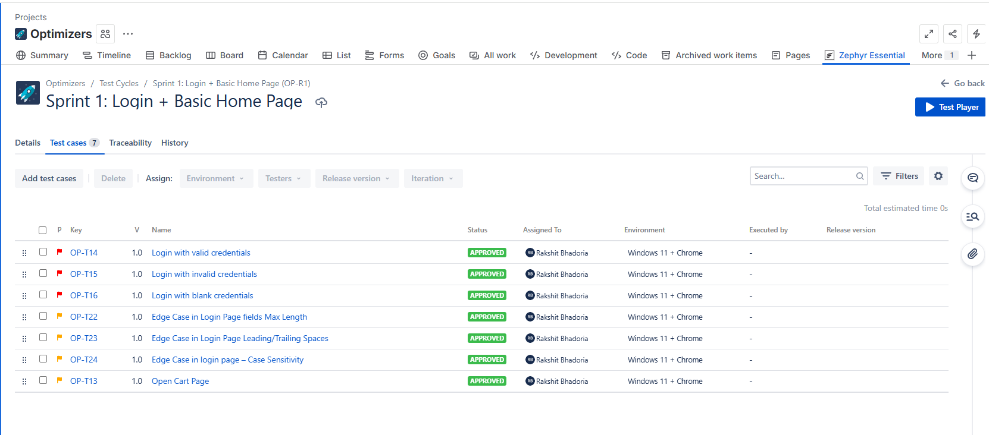
Zephyr
Board
Test Cycle View – Shows one cycle with all test cases inside the test cycle

Slide 20
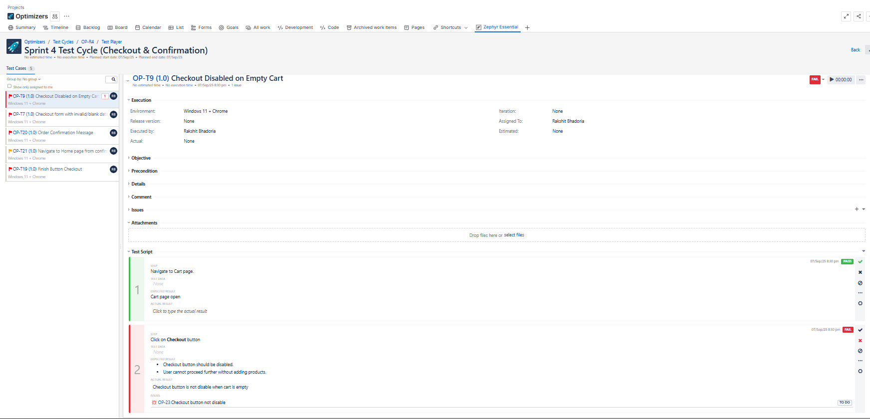
Zephyr
Board
Failed Test Handling – When a test fails, we can create an issue/bug at that failed step.

Slide 21
Zephyr
Board
Issue Linking – Reported issues are linked to the respective user story they block.

Slide 22

Test
Report
Key milestones
LAUNCH
TESTING
DEVELOPMENT
CONCEPT
ANALYSIS
JAN
FEB
MAR
APR
MAY
JUN
JUL
AUG
SEP
OCT
NOV
DEC

Slide 23
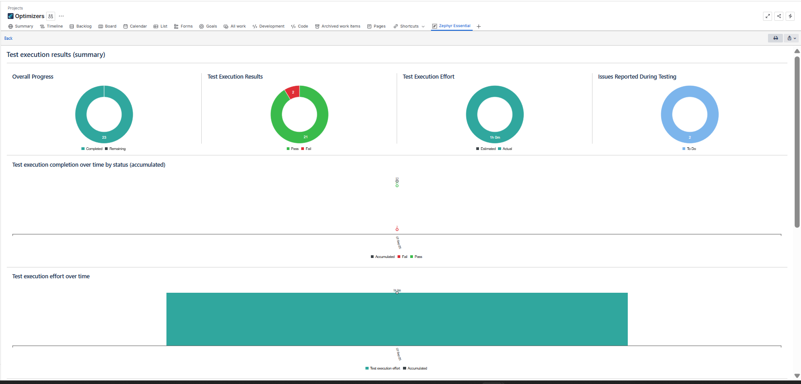
Test
Report
Zephyr Test Report – Provides execution status of test cases (Pass/Fail/Blocked), linked with user stories for better traceability.

Slide 24

Jenkins
We're well positioned to win in this market.
Top
LOGO
LOGO
Left
Right
LOGO
LOGO
Bottom

Slide 25
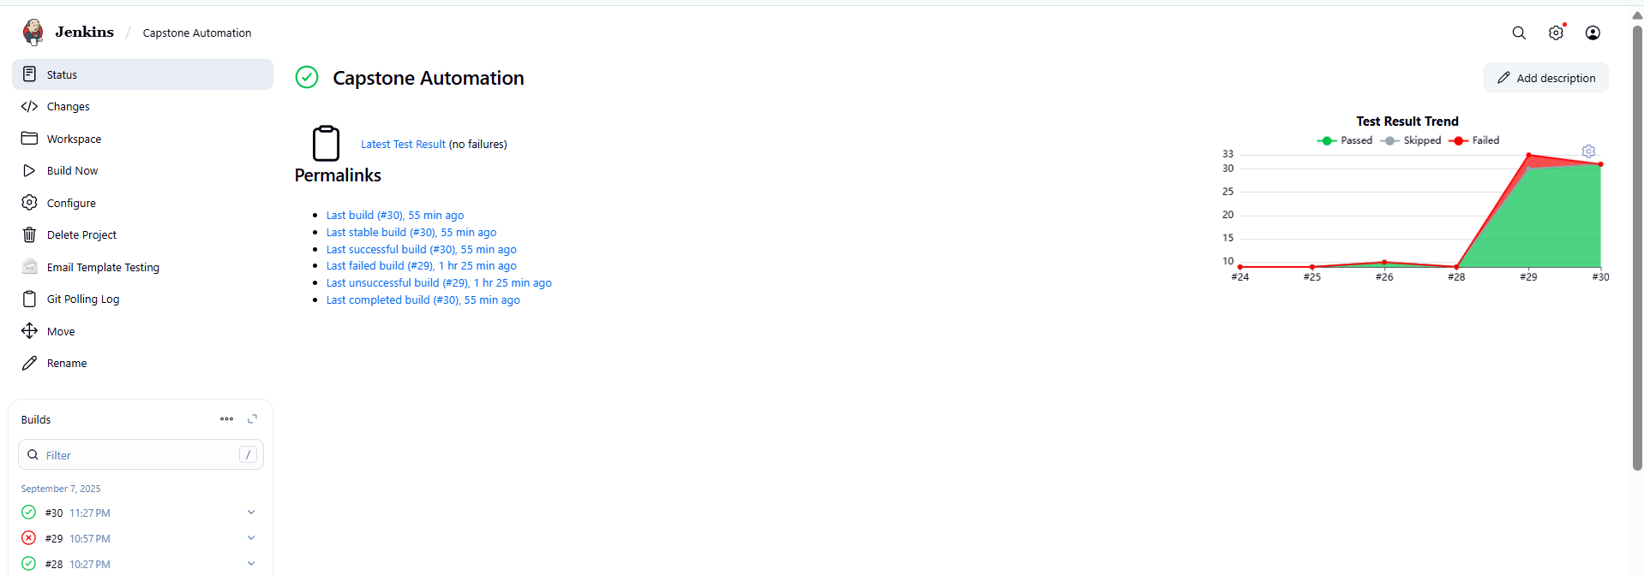
Jenkins
Job View (Capstone Automation) – Displays build history with a graph showing pass/fail trends for each build.

Slide 26
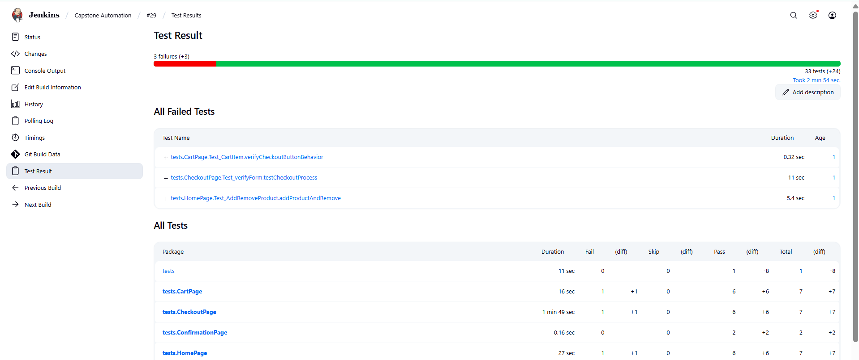
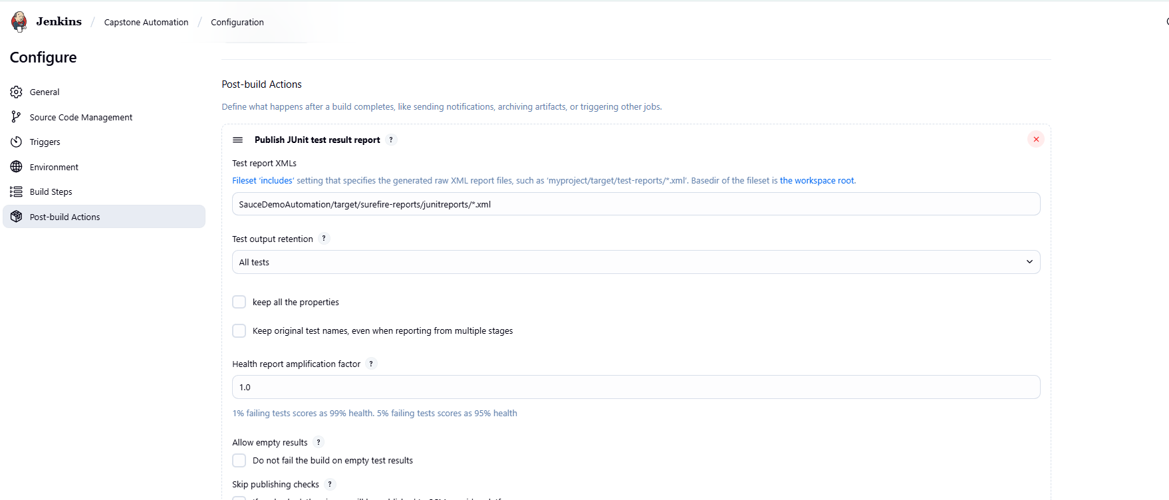
Jenkins
Post-Build Action (JUnit Reports) – Publishes detailed test results after every build for easy review.

Slide 27
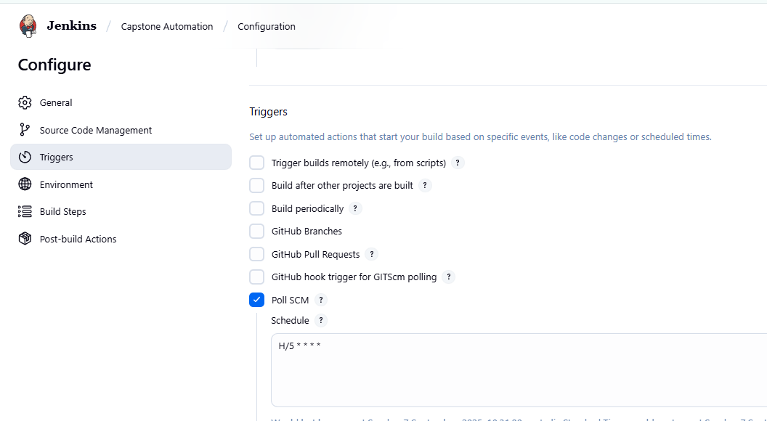
Jenkins
GitHub Trigger – Automatically starts a build whenever a new commit is pushed to the repository.
Poll SCM (Source Code Management)- Poll SCM is a Jenkins option that periodically checks for changes in the repo instead of building on a fixed schedule. If changes exist, it triggers the pipeline automatically.

Slide 28
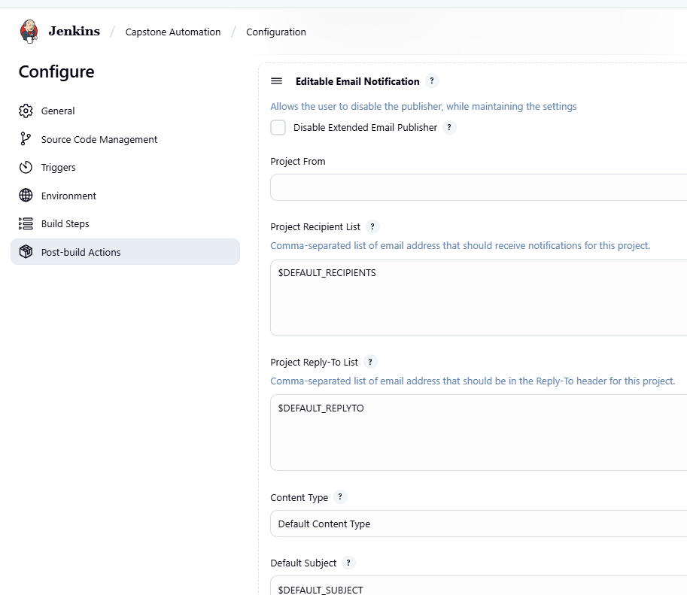
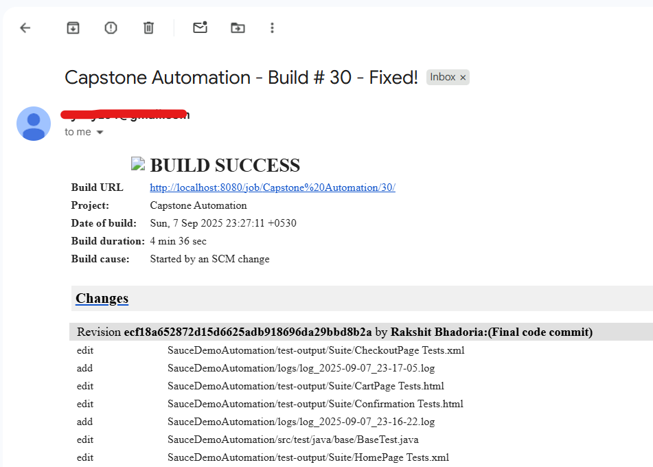
Jenkins
Email Notification – Sends an email after each build with logs attached, indicating success or failure.

Slide 29



Eclipse
&
GitHub
Key metrics
$97M+
x10
78%
Provide more information about this key performance indicator.
Provide more information about this key performance indicator.
Provide more information about this key performance indicator.
99%
770K+
$1.7M
Provide more information about this key performance indicator.
Provide more information about this key performance indicator.
Provide more information about this key performance indicator.

Slide 30
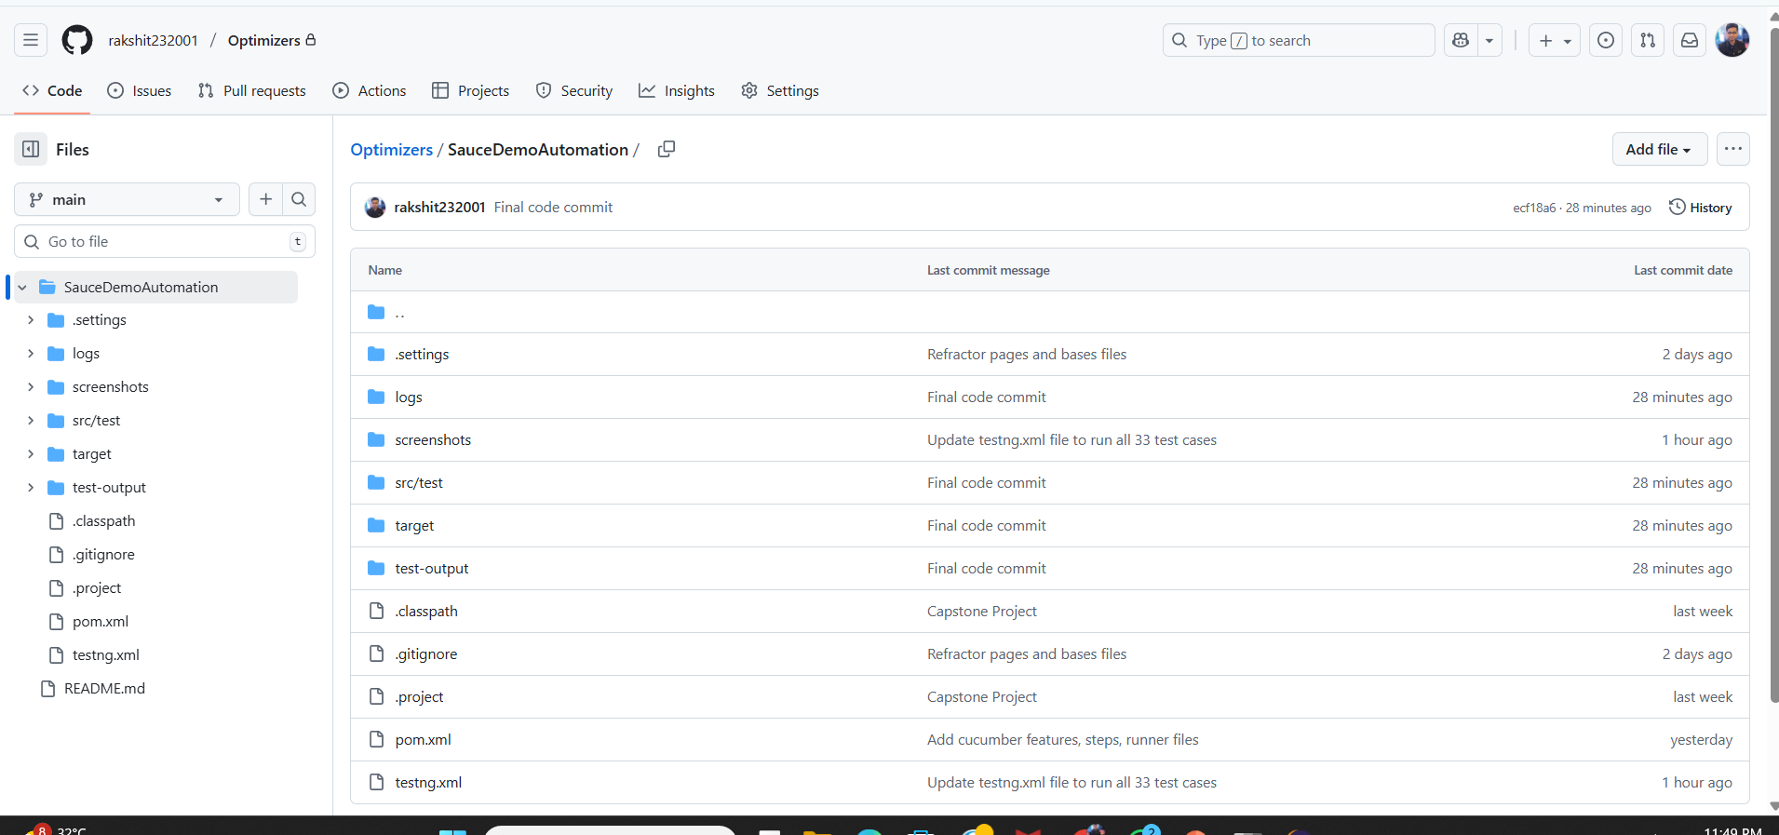
Eclipse & GitHub
GitHub Repository – Shows all project files and folders stored online for version control and collaboration.

Slide 31
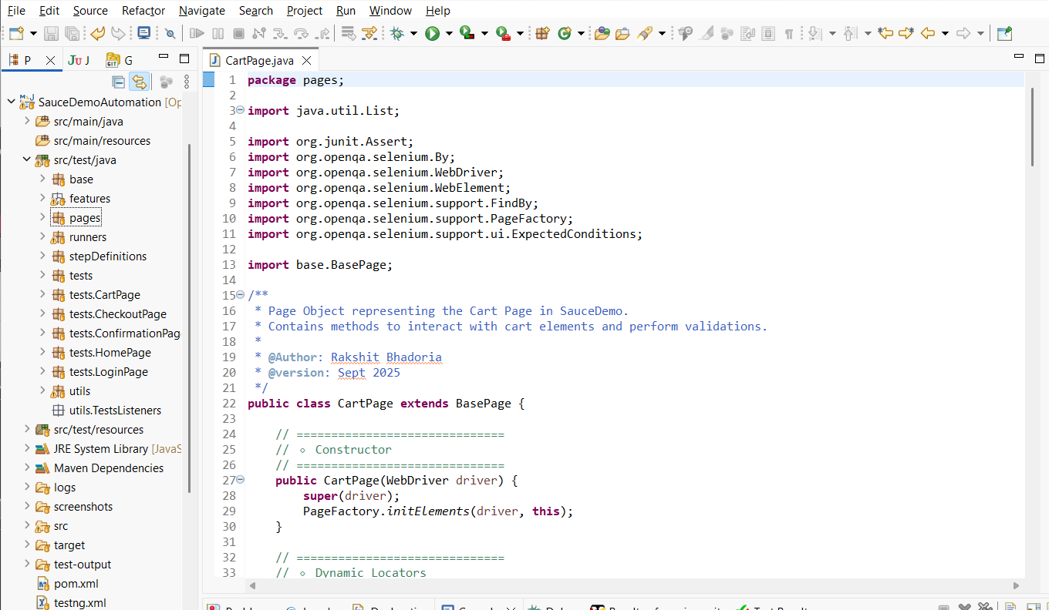
Eclipse & GitHub
Eclipse IDE – Displays the local folder structure and files in the workspace for easy development and debugging.

Slide 32


End
Our top experts are ready to reach the goals
Obi Wan
Han Solo
Princess Leia
Raminta Art
One Skill
CEO
CTO
CFO
CMO
PPT

Slide 33
The End
Thank You!

